Slide 1
CSE7302 - INTERNSHIP Review-III Presentation CLIENT SUCCESS INTERN
Student Details
Name | ADWAITH SAI KRISHNA PANDA
Roll No | 20221CBC0017
Section | 8 CBC-1
Under the Supervision of,
Dr. Shanmugarathinam G
Professor,
Presidency School of CSE
Presidency University
Name of the Program: B.Tech
Name of the HoD: Dr. Pravinth Raja
Name of the Program Internship Coordinator: Ms Nisha Robin Rohit
Name of the School Internship Coordinator: Dr. Md Ziaur Rahman

Slide 2
Content
About Company or Organization
Working domain or the technology
About your team and reporting Manager
Challenges Faced in Internship
Objectives of the work
Proposed System
Problem Statement
System Requirements
Advantages of proposed System
System Design
System Implementation
Internship Roadmap
Github Link

Slide 3
About Company or Organization
Talent Recruit is an advanced Recruitment and Onboarding platform designed to simplify, automate, and enhance the entire hiring lifecycle. It leverages cutting-edge technologies such as Machine Learning and Artificial Intelligence to help organizations attract, screen, evaluate, and hire the right talent efficiently and accurately.
One of its key highlights is ERIKA – the 24×7 Robotic Recruiter, which automates candidate engagement, interview scheduling, follow-ups, and communication, ensuring a seamless and responsive recruitment experience for both recruiters and candidates. ERIKA reduces manual effort, improves turnaround time, and enhances candidate satisfaction through continuous availability and intelligent interaction.
Talent Recruit enables recruiters to manage job postings, track applications, shortlist candidates, conduct assessments, schedule interviews, and complete onboarding processes within a single integrated platform. Its AI-driven analytics and smart recommendations help recruiters make data-driven hiring decisions, minimize bias, and improve overall hiring quality.

Slide 4
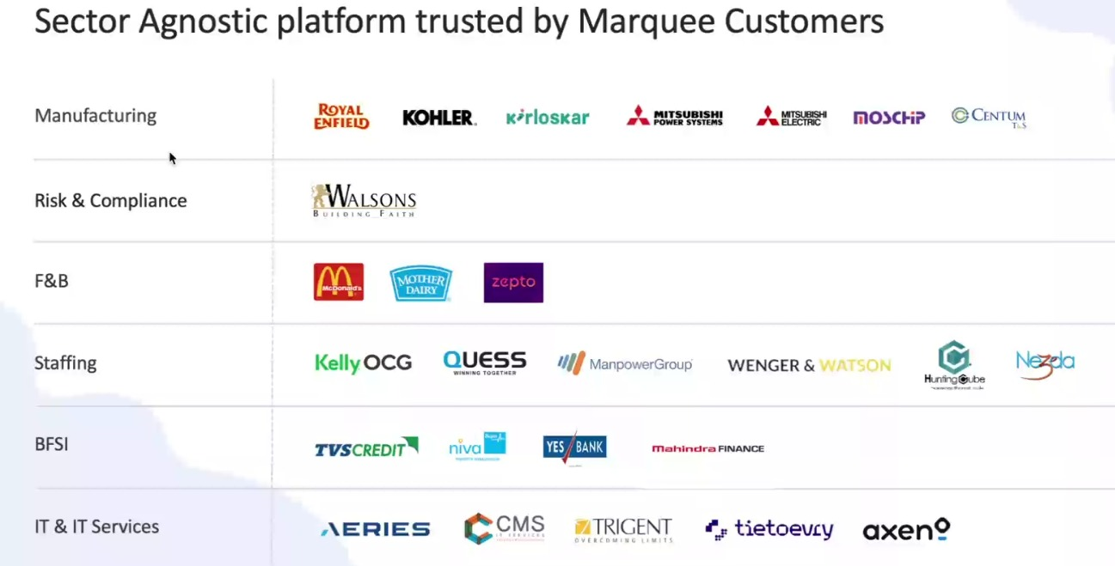
Our Clients

Slide 5
Working domain or the technology
Artificial Intelligence (AI) for intelligent recruitment automation
Machine Learning (ML) for resume screening and candidate ranking
Natural Language Processing (NLP) for chatbot and candidate interaction
Applicant Tracking System (ATS) architecture
SaaS (Software as a Service) cloud-based platform model
Database Management Systems for candidate and job data storage
REST APIs for integration with job portals and communication tools
Chatbot Technology (ERIKA – Robotic Recruiter)
Recruitment Analytics and Reporting Dashboards
Workflow Automation Systems

Slide 6
About your team and reporting Manager
Team Structure, Project, Reporting & Technology Understanding
Our team consists of 9 members, guided by our Reporting Manager, Mr. Ashish Meridatta.
Currently, we are in the training phase on the company’s ATS (Applicant Tracking System) product.
We are learning how each technology supports the recruitment process:
Technology Understanding:
AI & ML: Helps in resume screening and candidate ranking.
NLP: Enables chatbot communication and candidate interaction.
ATS Workflow: Helps track candidates across hiring stages.
Databases: Store and manage candidate and job data.
APIs: Integrate job portals and communication tools.
Dashboards & Analytics: Provide recruitment performance insights.
This training helps us understand how technology solves real recruitment challenges.
After training, we will be assigned to live projects for practical client exposure.

Slide 7
Challenges Faced in Internship
I was selected through my college campus placement process. Clearing the interview with the company’s CCO was a major challenge, as it involved in-depth technical questions, role-based scenarios, and problem-solving assessments. This experience tested my analytical thinking, technical knowledge, and ability to perform under pressure, helping me gain confidence and clarity about industry expectations.

Slide 8
Objectives of the work
To understand ATS system architecture and recruitment workflows.
To support AI-based resume parsing and candidate shortlisting processes.
To assist in database validation and candidate data management.
To ensure accurate workflow automation across hiring stages.
To support API-based integrations with job portals and communication tools.
To analyze recruitment dashboards and system reports.
To help in identifying and resolving basic system-level issues.
To improve overall system efficiency and data consistency.

Slide 9
Proposed System/Work
AI-Powered Applicant Tracking System
Automated resume screening and candidate ranking
Chatbot-based candidate engagement (ERIKA)
Centralized recruitment workflow management
Tailored Analytics and insights customize to specific clients and strategic plans
Power BI and Tableau integrations as per business plans

Slide 10
Problem Statement
To design and implement an interactive recruitment analytics dashboard using Power BI that transforms cleaned transactional data into meaningful insights through data modeling, DAX-based KPIs, time-based analysis, and recruiter-level performance evaluation to support data-driven decision-making.

Slide 11
System Requirements
Web-based ATS platform
Cloud infrastructure
Database for candidate and job data
API integrations with job portals and communication tools
Power BI and Tableau API connectivity
Support for Advanced Analytics via REST APIs enabling real time data synchronization

Slide 12
System Requirements Cont…
Security aspects:
Role based data Access (RBAC)
Securing data Sharing across different clients.

Slide 13
Advantages of proposed System/Work
Reduces manual effort in recruitment
Improves hiring accuracy and speed
Enhances candidate experience
Supports data-driven hiring decisions
Data Driven Decision Making
Actionable Insights
Predictive Modeling

Slide 14
Advantages of proposed System/Work cont…
Improved Client and Stakeholder Satisfaction
High Fidelity Visuals.
Bespoke Client Reporting

Slide 15
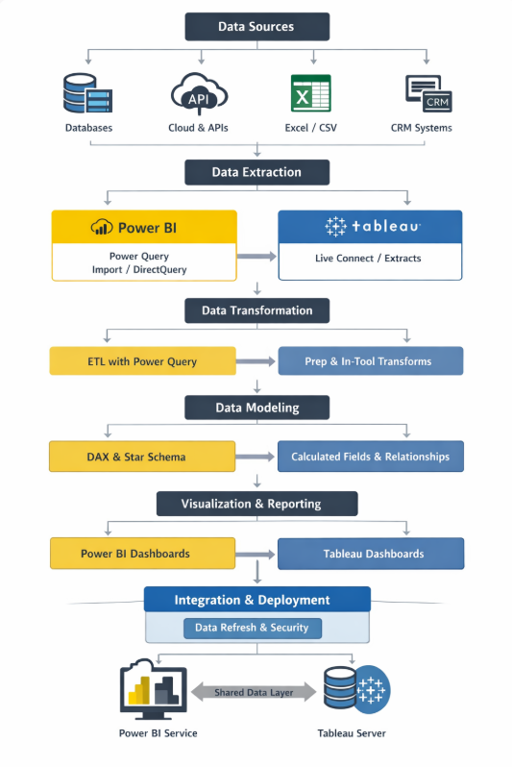
Working Process

Slide 16
Overview – Power BI
Objective To prepare raw sales data for analysis using Power BI by performing initial data cleaning and transformation.
Tools Used
Power BI Desktop
Power Query Editor
Work Performed
Imported a structured Excel dataset into Power BI
Accessed Power Query Editor to perform data preparation
Reviewed dataset structure and column consistency

Slide 17
Data Modeling Implementation
Created a separate Date Dimension table
Established proper Many-to-One relationship
Implemented structured BI data modeling
Enabled accurate time-based analytics

Slide 18
KPI Development (DAX Measures)
Developed key performance indicators using DAX:
Total Revenue
Total Hires
Offer Acceptance Rate
Average Time to Hire
Revenue per Hire
Recruiter-level performance metrics

Slide 19
Dashboard & Visual Analytics
Built an interactive recruitment analytics dashboard including:
Hiring trend analysis (time-based)
Revenue by region
Department-wise hiring performance
Recruiter performance comparison
Recruitment pipeline (Funnel analysis)

Slide 20
Advanced Features Implemented
Implemented Slicers for dynamic filtering
Created Drill-through page for recruiter-level analysis
Enabled interactive, multi-dimensional reporting
Designed executive-style KPI summary layout

Slide 21
Learning Outcome
Converted raw data into business insights
Applied BI lifecycle concepts in practice
Demonstrated DAX, modeling, and visualization skills
Built a professional recruitment analytics solution

Slide 22
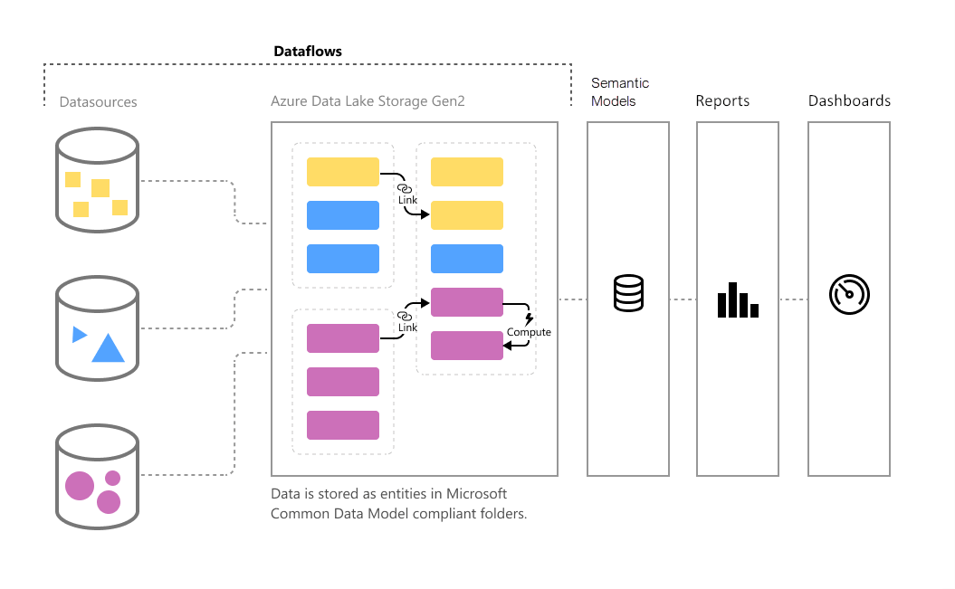
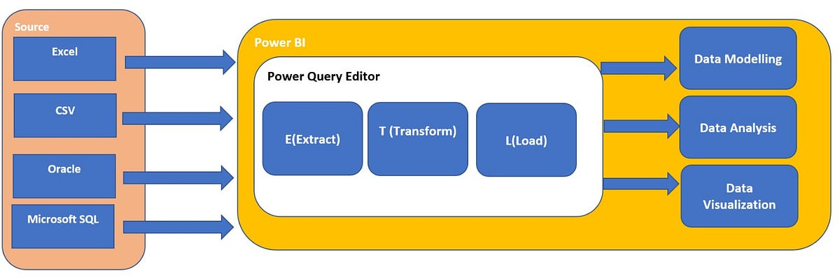
Architecture

Slide 23
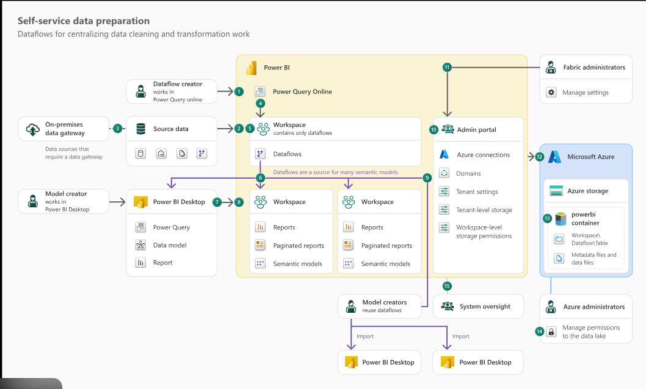

Slide 24
Visualization and Deployment
Dashboards and reports are created for business users using:
Power BI Reports and Dashboards
Tableau Interactive Visualizations
Reports are published to:
Power BI Service
Tableau Server

Slide 25
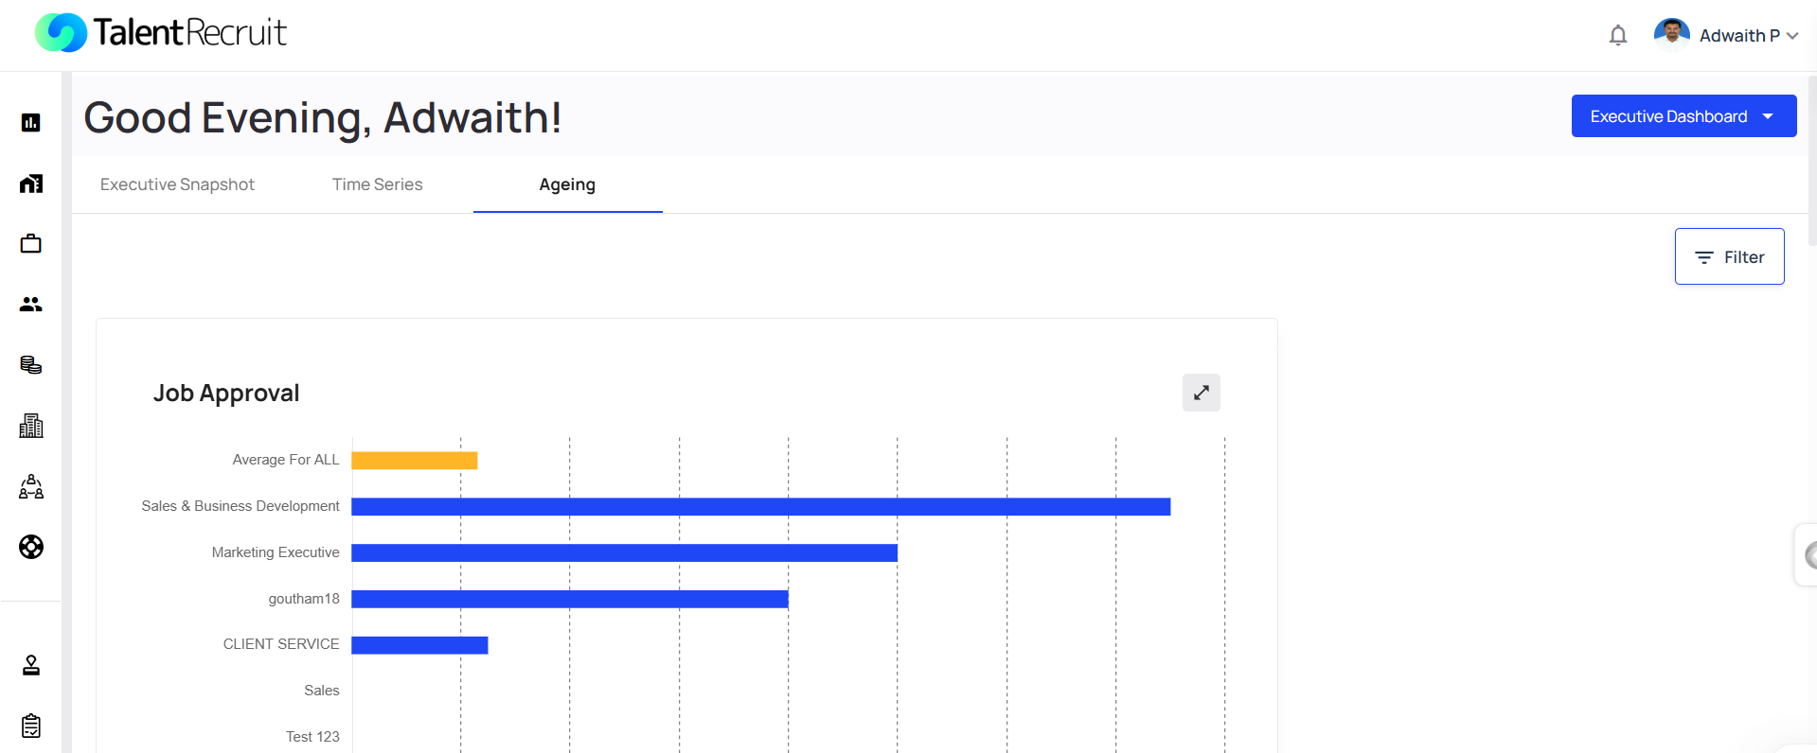
Advanced Analytics

Slide 26
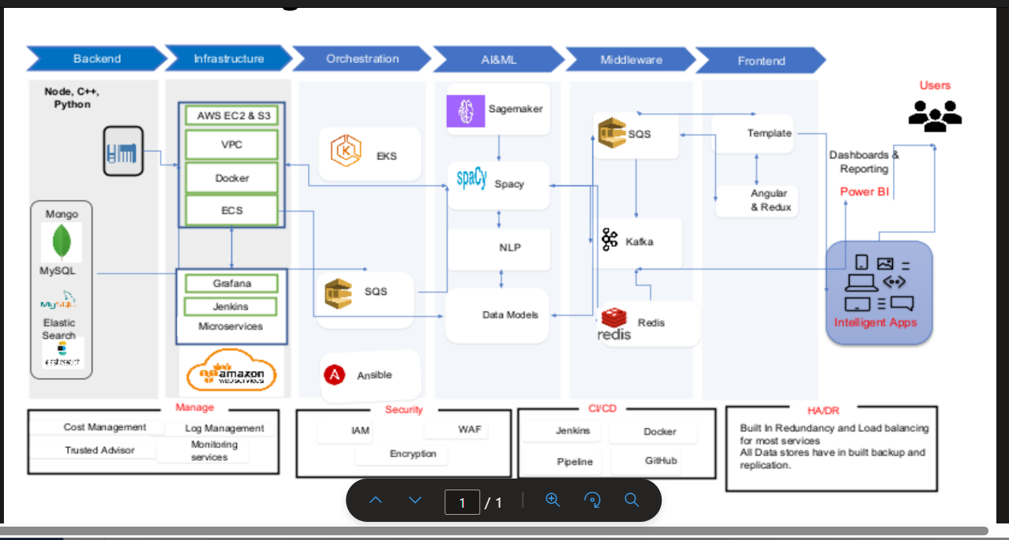
System Design

Slide 27
System Implementation
Backend Layer
Developed using Node.js, C++, and Python
Microservices-based architecture
Databases: MongoDB, MySQL, Elasticsearch
REST APIs for system communication
Cloud & Infrastructure
Hosted on AWS (EC2, S3, VPC)
Containerized using Docker
Orchestrated via EKS/ECS
Monitoring with Grafana
Automation using Jenkins & Ansible

Slide 28
System Implementation
Middleware & Messaging
Kafka & SQS for asynchronous communication
Redis for caching and performance optimization
Frontend & Reporting
UI built with Angular & Redux
Dashboards & Reporting through Power BI
Supports intelligent, data-driven applications
Security & Reliability
IAM, WAF, Encryption
Load balancing & redundancy
Backup & replication for high availability
AI & Processing Layer
Model training using Amazon SageMaker
NLP processing using SpaCy
Data models for intelligent insights

Slide 29
Internship Road Map
Note: Write in the below table what u will be achieving in each review
Review 1
Product training and understanding the mechanisms
Review 2
Integrating all Advanced Analytics tools to the environments.
Review 3
Review 4
Final Review
Involved data modeling, DAX KPI creation, interactive dashboard development, slicers, drill-through analysis, and recruitment performance insights generation

Slide 30
Github Link
https://github.com/Jann-2004/Internship-Work-Adwaith_20221CBC0017

Slide 31
Q&A

Slide 32
Thank you !!

